Slide 1


JAVA INTERVIEW BOOTCAMP ADVANCE CONCEPTS
Lecture 18
Exception Handling

Slide 2
CHAPTER 18
EXCEPTION HANDLING
Topics Covered
Introduction
try-catch-finally
Checked Exceptions
UnChecked Exceptions

Slide 3
What Is An Exception?
Error that occurs during runtime
Cause normal program flow to be disrupted
Examples
– Divide by zero errors
– Accessing the elements of an array beyond its range
– Invalid input
– Hard disk crash
– Opening a non-existent file

Slide 4
Example
1 class DivByZero {
2 public static void main(String args[]) {
3 System.out.println(3/0);
4 System.out.println(“Pls. print me.”);
5 }
6 }

Slide 5
What Java Does When An Exception Occurs ?
Runs the Default Exception Handler
Features Of Default Exception Handler
– Provided by Java runtime
– Prints out exception description
– Prints the stack trace Hierarchy of methods where the exception occurred
– Causes the program to terminate

Slide 6
What Java Does When An Exception Occurs ?
In our example this message will be displayed
Exception in thread "main" java.lang.ArithmeticException: / by zero at DivByZero.main(DivByZero.java:3)

Slide 7
What Happens Internally When An Exception Occurs ?
When an exception occurs within a method, the method creates an exception object and hands it off to the runtime system .
Exception object contains information about the error, including it’s type and the state of the program when the exception occurred
The runtime system searches the call stack for a method that contains an exception handler

Slide 8
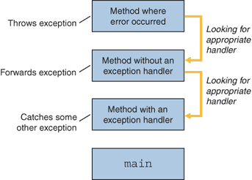
What Happens Internally When An Exception Occurs ?

Slide 9
What Happens Internally When An Exception Occurs ?
When an appropriate handler is found, the runtime system passes the exception to the handler
An exception handler is considered appropriate if the
type of the exception object thrown matches the type
that can be handled by the handler

Slide 10
What Happens Internally When An Exception Occurs ?
The exception handler chosen is said to catch the exception.
If the runtime system exhaustively searches all the methods on the call stack without finding an appropriate exception handler, the runtime system(and, consequently, the program) terminates and uses the default exception handler

Slide 11
Benefits Of Exception Handling Compared To Regular Code
In traditional programming, error detection,reporting, and handling often lead to confusing spaghetti code
Consider pseudocode method here that reads an entire file into memory
readFile {
open the file;
determine its size;
allocate that much memory;
read the file into memory;
close the file;
}

Slide 12
Benefits Of Exception Handling Compared To Regular Code
In traditional programming, To handle such cases,the readFile function must have more code to do error detection, reporting, and handling.

Slide 13
Benefits Of Exception Handling Compared To Regular Code
errorCodeType readFile {
initialize errorCode = 0;
open the file;
if (theFileIsOpen) {
determine the length of the file;
if (gotTheFileLength) {
allocate that much memory;
if (gotEnoughMemory) {
read the file into memory;
if (readFailed) {
errorCode = -1;
}
} else {
errorCode = -2;
}

Slide 14
Benefits Of Exception Handling Compared To Regular Code
} else {
errorCode = -3;
}
close the file;
if (theFileDidntClose && errorCode == 0) {
errorCode = -4;
} else {
errorCode -5;
}
} else {
errorCode = -5;
}
return errorCode;
}

Slide 15
Benefits Of Exception Handling Compared To Regular Code
Exceptions enable you to write the main flow of your code and to deal with the exceptional cases elsewhere

Slide 16
Benefits Of Exception Handling Compared To Regular Code
readFile {
try {
open the file;
determine its size;
allocate that much memory;
read the file into memory;
close the file;
} catch (fileOpenFailed) {
doSomething;
} catch (sizeDeterminationFailed) {
doSomething;
} catch (memoryAllocationFailed) {
doSomething;
} catch (readFailed) {
doSomething;
} catch (fileCloseFailed) {
doSomething;
}}

Slide 17
Does Exception Handling Offer Any Other Benefits ?
Apart from separating concerns between defining the regular program logic and the exception handling code, exceptions also can help pinpoint the offending code (code that throws an exception), together with the method in which it is defined, by providing a stack trace of the exception or error.

Slide 18
Does Exception Handling Offer Any Other Benefits ?
An example:
public class Trace { // line 1
public static void main(String args[]) { // line 2
method1(); // line 3
} // line 4
public static void method1() { // line 5
method2(); // line 6
} // line 7
public static void method2() { // line 8
String[] students = {"Shreya", "Joseph"}; // line 9 System.out.println(students[5]); // line 10
} // line 11
} // line 12

Slide 19

Does Exception Handling Offer Any Other Benefits ?
method2() tries to access the array element of students at index 5, which is an invalid index for array students, so the code throws the exception ArrayIndexOutOfBoundsException at runtime
Following is the exception message and the list of methods that were involved in calling the code that threw the exception, starting from the entry point of this application, the main method

Slide 20
Creating try-catch-finally blocks
try - catch - finally
try {
//do something
}
catch (ExceptionType name) {
}
catch (ExceptionType name) {
}
finally {
//clean up
}

Slide 21
Creating try-catch-finally blocks
The three important keywords for Exception Handling are try, catch, and finally.
Try what? First you try to execute your code. If it doesn’t execute as planned, you handle the exceptional conditions using a catch block.
Catch what? You catch the exceptional event arising from the code enclosed within the try block and handle the event by defining appropriate exception handlers.
What does finally do? Finally, you execute a set of code, in all conditions, regardless of whether the code in the try block throws any exceptions.

Slide 22
Popular Interview Question
Imagine you’re going river rafting on your vacation.
Your instructor informs you that while rafting, you might fall off the raft into the river while crossing the rapids.
In such a condition, you should try to use your oar or the rope thrown toward you to get back into the raft.
You might also drop your oar into the river while rowing your raft. In such a condition, you should not panic and should stay seated.
Whatever happens, you’ have to pay for this adventure sport.

Slide 23

Popular Interview Question

Slide 24

Popular Interview Question

Slide 25
Can you categorize the situations as normal flow /exceptions ?
You can compare river rafting to a class whose methods might throw exceptions.
Crossing the rapids and rowing a raft are methods that might throw exceptions.
Falling off the raft and dropping your oar are the exceptions.
The steps for getting back into the raft and not panicking are the exception handlers—code that executes when an exception arises.
The fact that you pay for the sport, whether you stay in the boat or not, can be compared to the finally block.

Slide 26
Implementing The Real Life Example
Let’s implement the previous real-life examples by defining appropriate classes and methods.
Declare two barebones exception classes—FallInRiverException and DropOarException—that can be thrown by methods in the class RiverRafting:
class FallInRiverException extends Exception {
}
class DropOarException extends Exception {
}

Slide 27
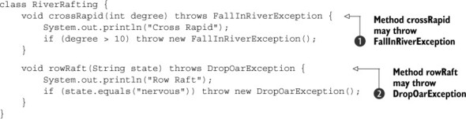
Implementing The Real Life Example
Design the class RiverRafting with methods crossRapid and rowRaft that may throw exceptions of type FallInRiverException and DropOarException

Slide 28
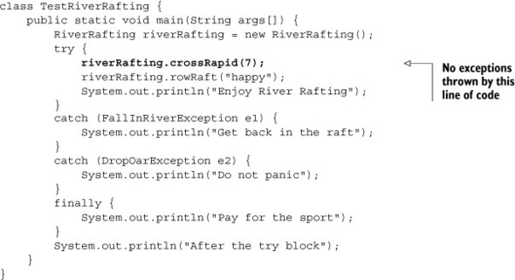
Implementing The Real Life Example
What is the output:
Output:
Cross Rapid
Row Raft
Enjoy River Rafting
Pay for the sport
After the try block

Slide 29
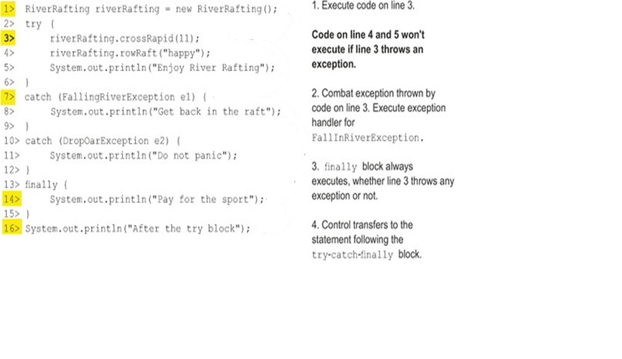
Implementing The Real Life Example
What is the output:
Output:
Cross Rapid
Get back in the raft
Pay for the sport
After the try block

Slide 30
Single try, Multiple catch
For a try block, we can define multiple catch blocks, but only a single finally block.
Multiple catch blocks are used to handle different types of exceptions.
A finally block is used to define cleanup code—code that closes and releases resources, such as file handlers and database or network connections.

Slide 31
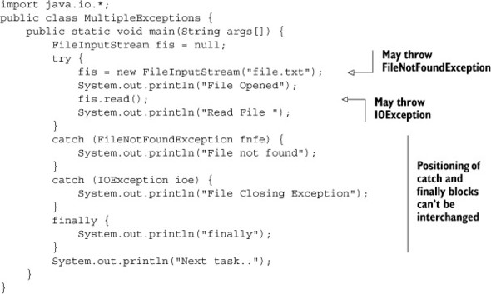
Single try, Multiple catch

Slide 32
Single try, Multiple catch
What is the output if the code is not able to open the file ?
File not found
finally
Next task..

Slide 33
Single try, Multiple catch
What is the output if the code is able to open the file but unable to read it?
File Opened
File Closing Exception
finally
Next task..

Slide 34
Single try, Multiple catch
What is the output if the no exception is thrown ?
File Opened
Read File
finally
Next task..

Slide 35
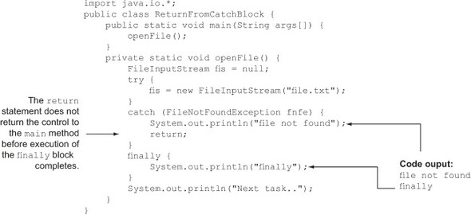
Will a finally block execute even if the catch block defines a return statement?
Yes , a finally block will execute even if the code in the try block or any of the catch blocks defines a return statement.

Slide 36
When will finally not execute ?
There are a few scenarios in Java in which a finally block does not execute:
Application termination—The try or the catch block executes System.exit(), which terminates the application
Exception occurs before try
Fatal errors—A crash of the JVM or the OS

Slide 37
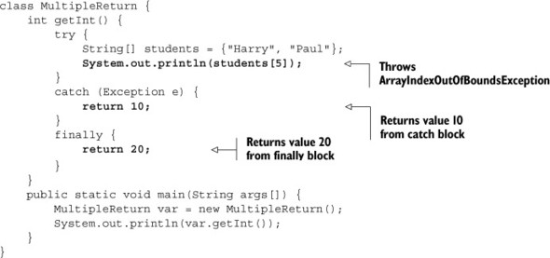
What happens if both a catch and a finally block define return statements?
If both catch and finally blocks define return statements, the calling method will receive a value from the finally block.
Output:
20

Slide 38
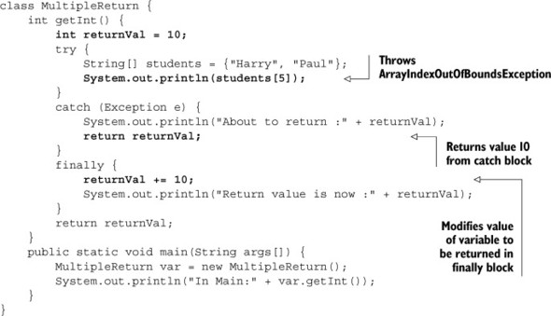
What happens if a finally block modifies the value returned from a catch block?
If a catch block returns a primitive data type, the finally block can’t modify the value being returned by it
Output:
About to return :10
Return value is now :20
In Main:10

Slide 39
What happens if a finally block modifies the value returned from a catch block?
Even though the finally block adds 10 to variable returnVal, this modified value is not returned to the method main.
Control in the catch block copies the value of returnVal to be returned before it executes the finally block, so the returned value is not modified when finally executes.

Slide 40
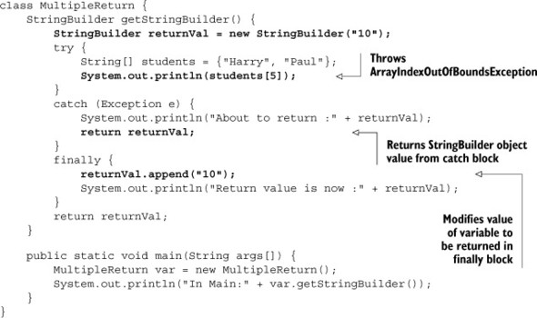
Will the preceding code behave in a similar manner if the method returns an object?
No, if a catch block returns an object, the finally block can modify the value being returned by it.
Output:
About to return :10
Return value is now :1010
In Main:1010

Slide 41
Conclusion
If a catch block returns a primitive data type, the finally block can’t modify the value being returned by it.
If a catch block returns a mutable object, the finally block can modify the value being returned by it.

Slide 42
Example
class Test
{
public String get(int x){
String a="10";
try
{
if(x>10)
throw new Exception();
}
catch(Exception e)
{
return a;
}
finally{
a="100";
}
return a;
}
}
class Sample
{
public static void main(String args[]) {
Test t=new Test();
System.out.println(t.get(12));
}
}
Output:
10

Slide 43
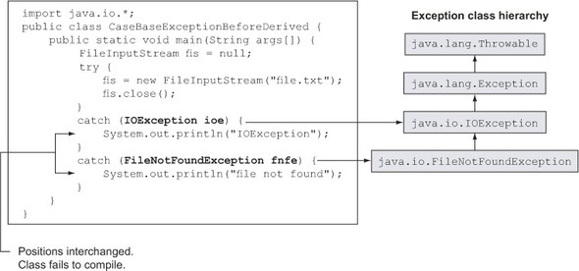
Does the order of the exceptions caught in the catch blocks matter?
Order doesn’t matter for unrelated classes. But it does matter for related classes sharing an IS-A relationship.

Slide 44
Rules To Remember
A try block may be followed by multiple catch blocks, and the catch blocks may be followed by a single finally block.
If a try block throws a checked exception and has only a finally block after it then the exception must be declared to be thrown by the method. Otherwise the code won’t compile.

Slide 45
Rules To Remember
The try, catch, and finally blocks can’t exist independently.
The finally block can’t appear before a catch block.
A finally block always executes, regardless of whether the code throws an exception.

Slide 46
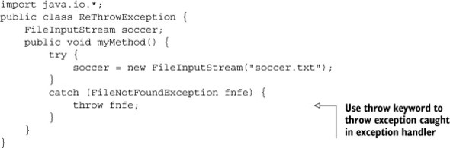
Can I rethrow an exception or the error I catch?
We can do whatever we want with an exception. Rethrow it, pass it on to a method, assign it to another variable, upload it to a server, send it in an SMS, and so on.
Output:
The code fails to compile:
ReThrowException.java:9: unreported exception java.io.FileNotFoundException; must be caught or declared to be thrown throw fnfe

Slide 47
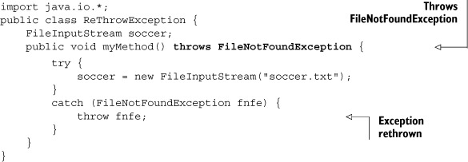
Can I rethrow an exception or the error I catch?
When we rethrow a checked exception, it’s treated like a regular thrown checked exception, meaning that all the rules of handling a checked exception apply to it

Slide 48
Point To Remember
Another interesting point to note is that the previous rule doesn’t apply to a RuntimeException.
We can rethrow a runtime exception, but we’re not required to catch it, nor must we modify our method signature to include the throws clause.

Slide 49
Can I declare my methods to throw a unchecked exception, instead of handling it?
Yes we can but it is of no use.
Because even if we write a unchecked exception with throws clause then also java never forces the caller to handle it

Slide 50
Can I declare my methods to throw a unchecked exception, instead of handling it?
Output:
The method is declaring an unhecked exception to be thrown
public static void accept() throws InputMismatchException
{
Scanner kb=new Scanner (System.in);
System.out.println("Enter a num");
int a=kb.nextInt();
System.out.println("You inputted :"+a);
}
public static void main(String [] args){
accept();
}
Output:
Calling code is not handling it. Still the program will compile and run

Slide 51
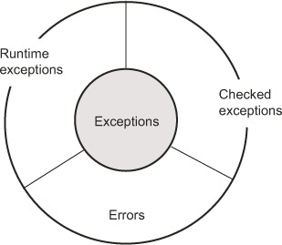
Exception Categories
Exceptions can be divided into three main categories:
Checked Exceptions
UnChecked Exceptions
Errors
For the Interview purpose, it’s important to have a crystal-clear understanding of these three categories of exceptions, including their similarities and differences.

Slide 52
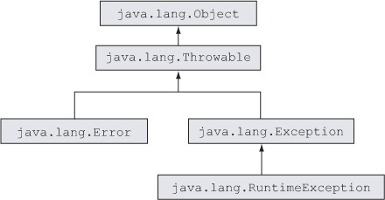
Class Hierarchy

Slide 53
Checked Exception
A checked exception is a subclass of class java.lang.Exception, but it’s not a subclass of java.lang.RuntimeException.
A checked exception is an unacceptable condition foreseen by the author of a method but outside the immediate control of the code.

Slide 54
Checked Exception
For example, FileNotFoundException is a checked exception.
This exception is thrown if the file that the code is trying to access can’t be found. When it’s thrown, this condition is outside the immediate control of the author of the code but it was foreseen by the author.

Slide 55
Rules For Handling Checked Exception
If a method uses another method that may throw a checked exception, one of the two following things should be true:
The method should be enclosed within a try-catch block
or
The method should specify this exception to be thrown in its method signature

Slide 56

Rules For Handling Checked Exception
Consider the following code:
This will fail to compile because the code in bold throws the checked exception FileNotFoundException, and the class neither enclosed this line of code within a try block nor specified that it would be thrown in its method signature.

Slide 57
Rules For Handling Checked Exception
If a method chooses not to handle the checked exception thrown by its code, it may choose to throw it, and its method signature must specify that:
import java.io.*;
public Class OpenFile{
public static void main(String [] args)throws FileNotFoundException{
FileInputStream fis=new FileInputStream(“file.txt”);
}
}

Slide 58
UnChecked Exception(Runtime exceptions)
An unchecked exception is a subclass of class java.lang.RuntimeException
A runtime exception is a representation of a programming error
These occur from inappropriate use of another piece of code.

Slide 59
UnChecked Exception(Runtime exceptions)
For example, NullPointerException
which occurs when a piece of code tries to execute some code on a variable that hasn’t been assigned an object and points to null
Similarly , StringIndexOutOfBoundsException
which occurs when we try to access a string outside it’s index range
A runtime exception may not be a part of the method
signature, even if a method may throw it.

Slide 60
UnChecked Exception(Runtime exceptions)
class InvalidAccess
{
public static void main(String [ ] args)
{
String[ ] students={“Amit”,”Sumit”};
int pos=1;
if(pos>0 && pos<=1)
System.out.println(students[students.length]);
}
}
This line will throw ArrayIndexOutOfBoundsException

Slide 61
Rules For Handling UnChecked Exception
Simply use try-catch with proper exception class
public class InvalidArrayAccess {
public static void main(String args[]) {
String[] students = {"Shreya", "Joseph"};
try {
System.out.println(students[5]);
}
catch (ArrayIndexOutOfBoundsException e){ System.out.println("Exception");
}
System.out.println("All seems to be well");
}
}
Output
Exception
All seems to be well

